Slide 1



REALTIME AI POWERED SOCIAL MEDIA
A Social media , that embedded with advance AI technologies to empower and begin new social media era

Slide 2
REALTIME AI POWERED SOCIAL MEDIA
TEAM MEMBERS RANJITH S (211420104221)
PRITHVIRAJ M
(211420104204)
OUR GUIDE Mr. D ELANGOVAN, M.E, Ph.D

Slide 3



ABSTRACT
Social media has faced lots of development from the past 15 years.
But even now , we haven’t experienced the power of Social media with Integration of new technologies.
Social media integration with recent Technologies like VR , Blockchain , AI etc… can improve the personalized experience of the user.
To improve the user experience in social media, we can introducing this AI powered Social media.

Slide 4
OBJECTIVES
Enhance User Experience: Create a seamless and engaging social media experience through personalized content recommendations and intuitive user interface design.
Improve Content Relevance: Utilize AI-driven sentiment analysis and content recommendation algorithms to surface high-quality and relevant content tailored to each user's preferences.
Foster Community Well-being: Implement AI-powered moderation tools to mitigate negative sentiments, promote respectful interactions, and maintain a positive and inclusive online community.
Empower User Control: Provide users with greater control over their online experience by offering customizable privacy settings, content filters, and moderation preferences.

Slide 5
INTRODUCTION
Our social media app harnesses artificial intelligence (AI) to redefine the user experience. By leveraging advanced features such as sentiment analysis, content recommendation, and image/text recognition, we aim to create a more engaging, relevant, and inclusive platform. Through personalized content, user empowerment, and AI-driven moderation, our app prioritizes user satisfaction, content relevance, and community well-being. Join us as we revolutionize social media, making it safer, more personalized, and more meaningful for users worldwide.

Slide 6







EXISTING SYSTEM
Instagram is a Social media platform where people can do personnel
chat , create , view , like , comment , tag and share the contents.
Other Similar Applications are,

Slide 7
DISADVANTAGES
Privacy Concerns: Existing platforms often face criticism for privacy breaches and unauthorized data usage.
Misinformation: Proliferation of fake news and misinformation undermines credibility and can lead to confusion.
Cyberbullying: Platforms struggle to effectively combat cyberbullying and harassment, impacting user safety.
Algorithmic Bias: Algorithms may promote filter bubbles and reinforce biases, limiting exposure to diverse perspectives.
Addictive Design: Features like infinite scrolling and notifications can foster addictive behaviors and negatively impact mental health.
Authenticity Erosion: Focus on likes and followers can encourage performative behavior and superficial connections.

Slide 8
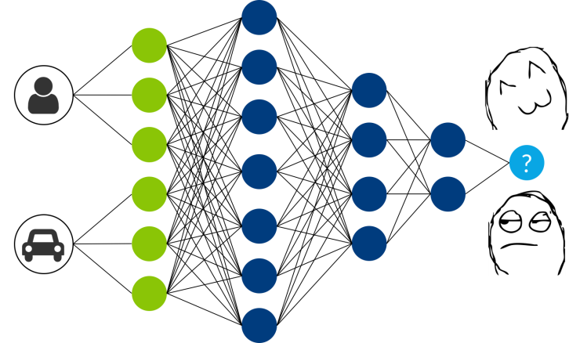


PROPOSED SYSTEM
A SOCIAL MEDIA with,
Personalized chat with sentiment analysis.
Comments classification for creator .
Emotion based post view system.

Slide 9
ADVANTAGES
Personalization: AI-driven features tailor content to user preferences.
Content Quality: Ensures high-quality, relevant content for users.
Community Safety: AI-powered moderation tools foster a safer environment.
User Control: Provides customizable privacy settings and filters.
Engagement: Innovative features drive increased user interaction.
Accessibility: Optimized for diverse devices and users.
Innovation: Evolves with user feedback and integrates new AI technologies.

Slide 10
MODULES
Sign-up Module:This module enables new users to create an account on the social media app. Users provide basic information such as their name, email address, and password.
Sign-in Module:This module allows users to log in to their account and access the social media platform. Users enter their email address and password to authenticate their identity.
Post Module:This module enables users to create new social media posts and share them with their audience. Users can write a text post, upload images or videos, and add hashtags and mentions.
Like and Comment Module:This module enables users to interact with social media content by liking posts and leaving comments. Users can express their sentiment towards a post through likes and comments.
Sentiment Analysis Module:This module analyzes the sentiment and mood of the social media content. It uses advanced algorithms to classify the sentiment of the content as positive, negative, or neutral.
Reporting and Visualization Module:This module generates reports and visualizations that provide insights into sentiment trends, audience engagement, and other key metrics. The reports can be customized to fit the specific needs of different organizations and can be exported in various formats.

Slide 11
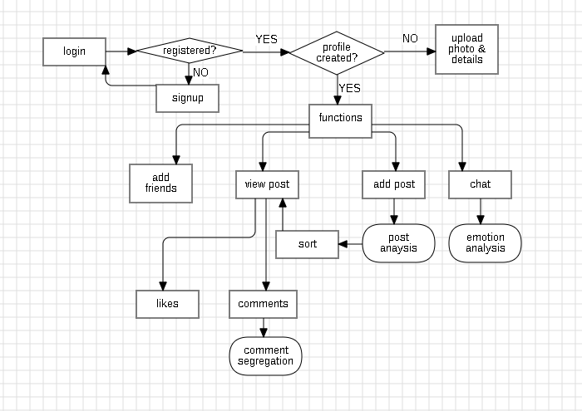
Architecture

Slide 12
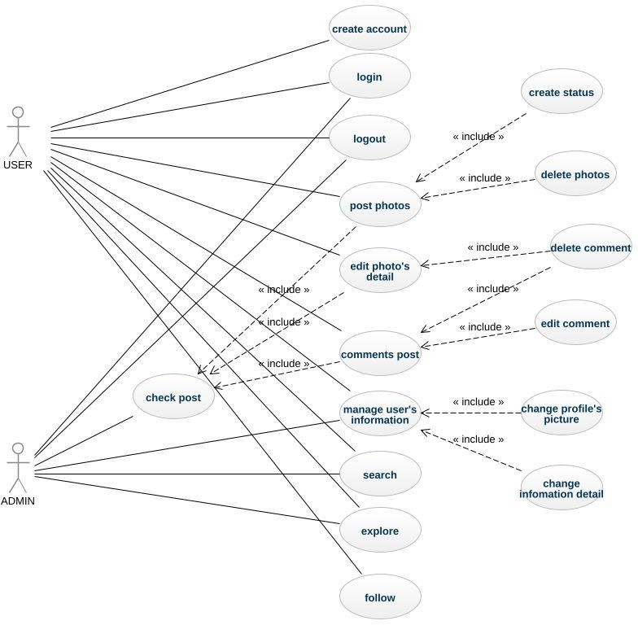
USECASE DIAGRAM

Slide 13
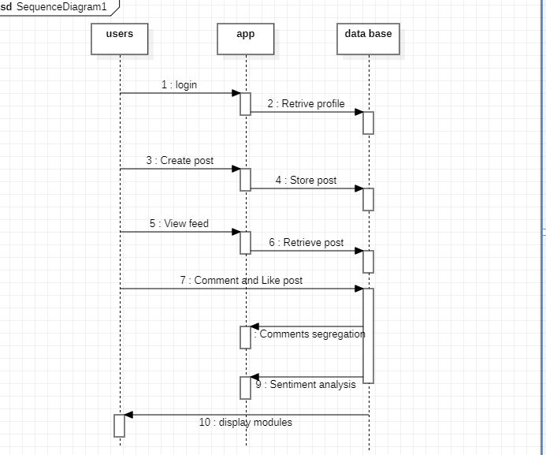
SEQUENCE DIAGRAM

Slide 14
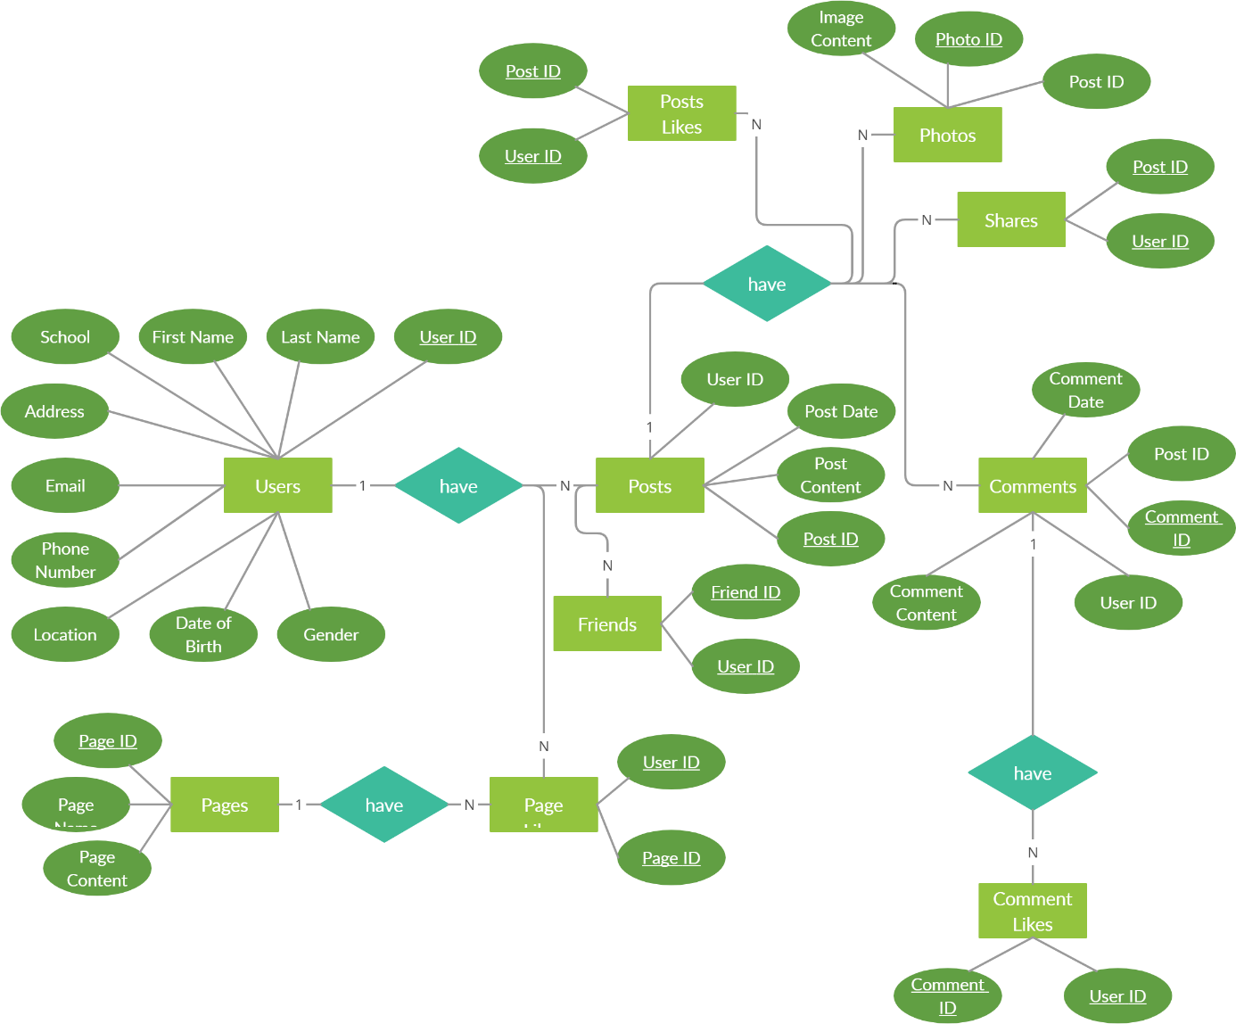
ER DIAGRAM

Slide 15
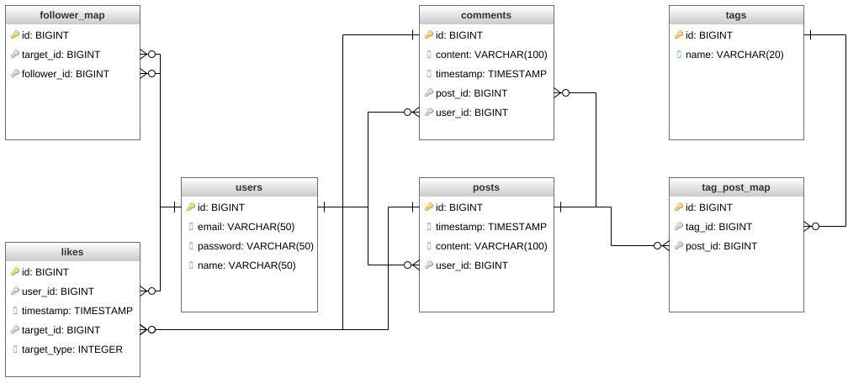
CLASS DIAGRAM

Slide 16
Tech Stack
Html
Css
Javascript
Bootstrap
Python
Django
Machine learning

Slide 17
HARDWARE REQUIREMENTS
Hard Disk : 250GB and Above
RAM : 4GB and Above
Processor : i3 and Above
Windows 7(1no)

Slide 18
FUTURE SCOPE
Advanced AI Integration: Explore more sophisticated AI algorithms for improved content recommendation and moderation.
Global Expansion: Expand user base by entering new markets and demographics.
Privacy Enhancement: Implement additional privacy features to ensure user data security.
AR/VR Integration: Integrate AR/VR technologies for immersive social media experiences.
Blockchain Implementation: Enhance transparency and security with blockchain technology.
Localization: Adapt app features and content to cater to diverse cultures and languages.
Partnerships: Collaborate with content creators and brands for innovative content and monetization.
Continuous Innovation: Regular updates based on user feedback and emerging trends to stay competitive.

Slide 19
Conclusion
AI-powered social media with sentiment analysis can provide valuable insights into the emotions and opinions expressed in social media content. The platform can help organizations make informed decisions, respond to customer needs and concerns, and identify emerging trends and opportunities. The system requirements for such a platform are significant, but the improvements in performance can be significant when compared to traditional sentiment analysis methods.

Slide 20
REFERENCES
[1] Andrey Bogomolov, Bruno Lepri, Michela Ferron, Fabio Pianesi, and Alex Pentland. Daily stress recognition from mobile phone data, weather conditions, and individual traits. In ACM International Conference on Multimedia, pages 477–486, 2014.
[2] Huijie Lin, Jia Jia, Jiezhon Qiu, Yongfeng Zhang, Lexing Xie, Jie Tang, Ling Feng, and Tat-Seng Chua, “Detecting Stress Based on Social Interactions in Social Networks”, IEEE Transactions on Knowledge and Data Engineering, 2017.
[3] Xiaojun Chang, Yi Yang, Alexander G Hauptmann, Eric P Xing, and YaoLiang Yu. Semantic concept discovery for large-scale zero-shot event detection. In Proceedings of International Joint Conference on Artificial Intelligence, pages 2234–2240, 2015.
[4] Li-fang Zhang, -Occupational stress teaching approach among Chinese academics, Educational Psychology, Volume 29, Issue 2, March 2009, pages 203 – 219.

Slide 21
[5] Q. Li, Y. Xue, J. Jia, and L. Feng, “Helping teenagers relieve psychological pressures: A microblog based system,” in EDBT, 2014.
[6] Aditya Mogadala, “Twitter User Behavior Understanding with Mood Transition Prediction” 20 [7] Yuanyuan Xue, Qi Li , Li Jin, Ling Feng, David A. Clifton,Gari D. Clifford ,“Detecting Adolescent Psychological Pressures from Micro-Blog”, 2013.
[8] Wanxiang Che, Zhenghua Li, and Ting Liu. Ltp: A Chinese language technology platform. In Proceedings of International Conference on Computational Linguistics, pages 13–16, 2010.
[9] Chih chung Chang and Chih-Jen Lin. Libsvm: a library for support vector machines. ACM TRANSACTIONS ON INTELLIGENT SYSTEMS AND TECHNOLOGY, 2(3):389–396, 2001.
[10] Dan C Ciresan, Ueli Meier, Jonathan Masci, Luca Maria Gambardella, and J ¨ urgen Schmidhuber. Flexible, high performance convolutional neural networks for image classification. In Proceedings of International Joint Conference on Artificial Intelligence, pages 1237–1242, 2011.

Slide 22
THANK YOU

